Slide 1
POWER BI AND SQL PROJECT : Internet Sales Report
By Amirul afiq rosli

Slide 2
Introduction
The Process flows
This is the project that I have done by using SQL for cleaning the dataset, Excel file to access an additional dataset and by using the Power BI to make business intelligence dashboard for visualization purpose.
Identify Objectives
Find Dataset
Cleaning Dataset
Upload Excel File and the Cleaned Dataset into PowerBI
Upload Into Github
Making Interactive Dashboard

Slide 3
Identify Objectives
Objectives :
Identify the products that have the best selling
Identify customers that buy the products the most.
Identify sales over time against budget.
What to do?
1. Making a dashboard overview of internet sales.
2. Making a detailed overview of Internet Sales per Customers.
3. Making a detailed overview of Internet Sales per Products.
Possible Result?
May identify the the products that have the best selling, so that can build selling strategy.
Can focus to which customers that buy the products the most to plan the customers repeating buying strategy.
Identify the profit to plan for selling strategy.

Slide 4
Find Dataset
Sources:
Dataset name : AdventureWorksDW2019.bak
First Link : https://learn.microsoft.com/en-us/sql/samples/adventureworks-install-configure?view=sql-server-ver15&tabs=ssms
Second Link : https://www.sendspace.com/file/z2s0gv
I followed the tutorial from this Youtube Playlist: https://youtube.com/playlist?list=PLMfXakCUhXsEUtk8c0zWr4whamGxLhAu0
This is the Github link of another source like complete dashboard from this Youtuber:
https://github.com/aliahmad-1987/DataAnalystProjectFromScratch_PBI_SQL_SalesAnalysis

Slide 5
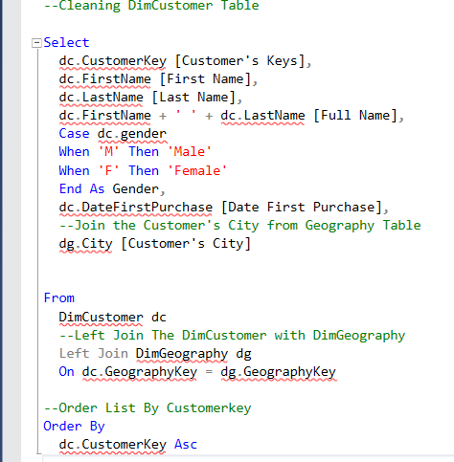
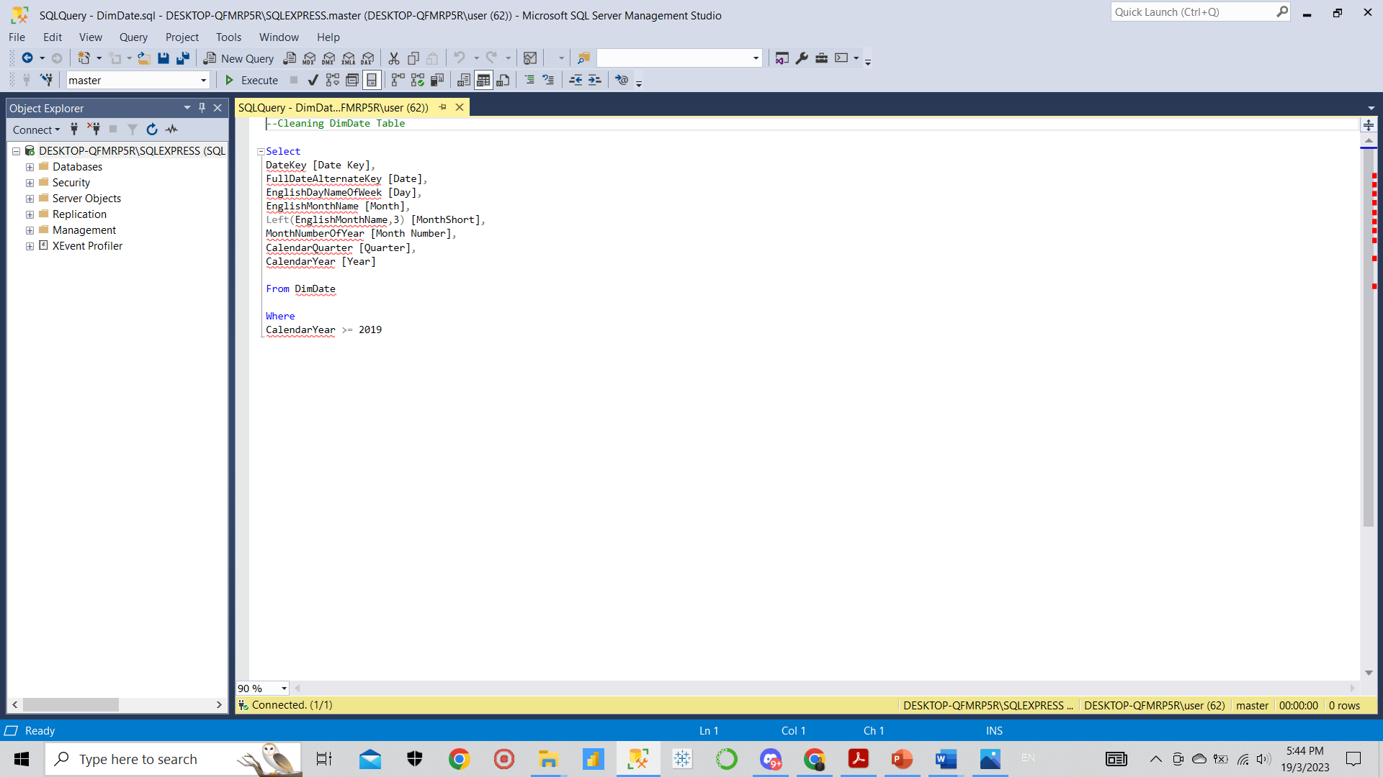
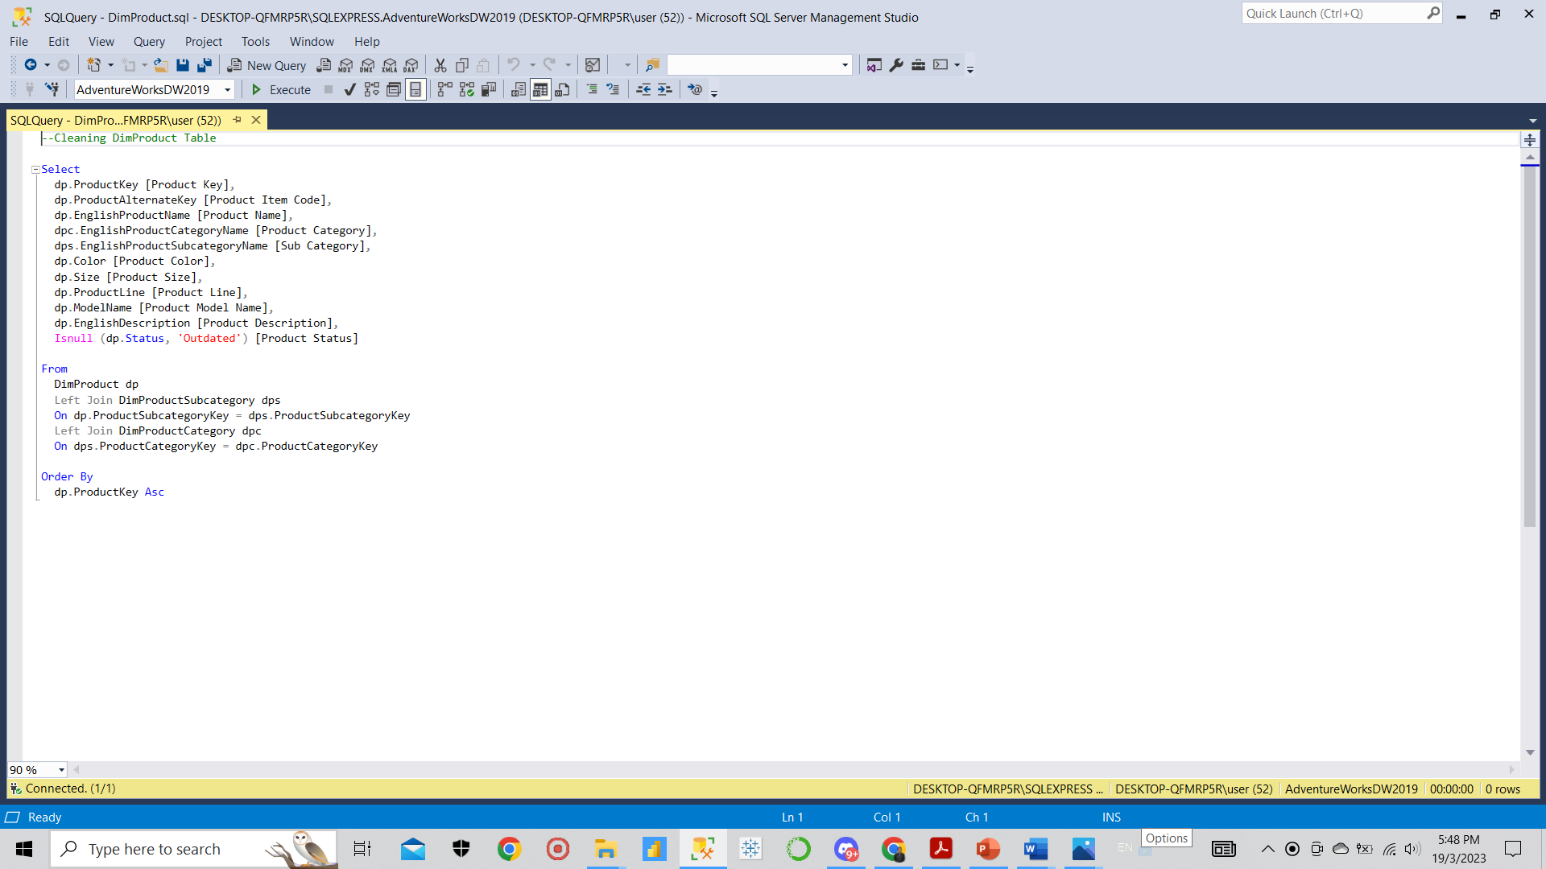
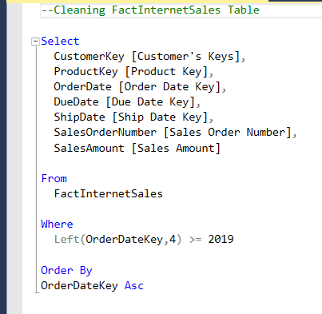
Cleaning Dataset
Tools :
SQL Server Management Studio Management Studio 19
What to do?
Cleaning the DimCustomer Table, DimDate Table, DimProduct Table, and FactInternetSales Table from
AdventureWorksDW2019.bak database.
2. The purpose is to extract the dataset to meaningful information.
The queries done :

Slide 6
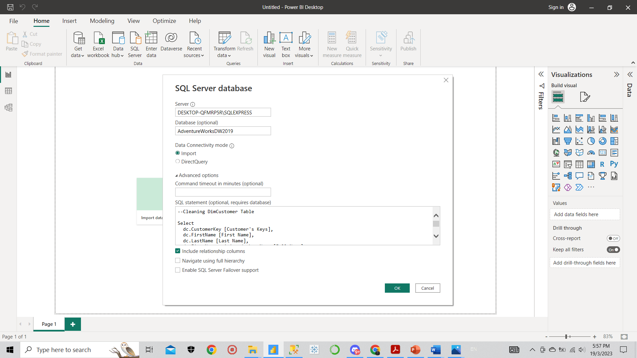
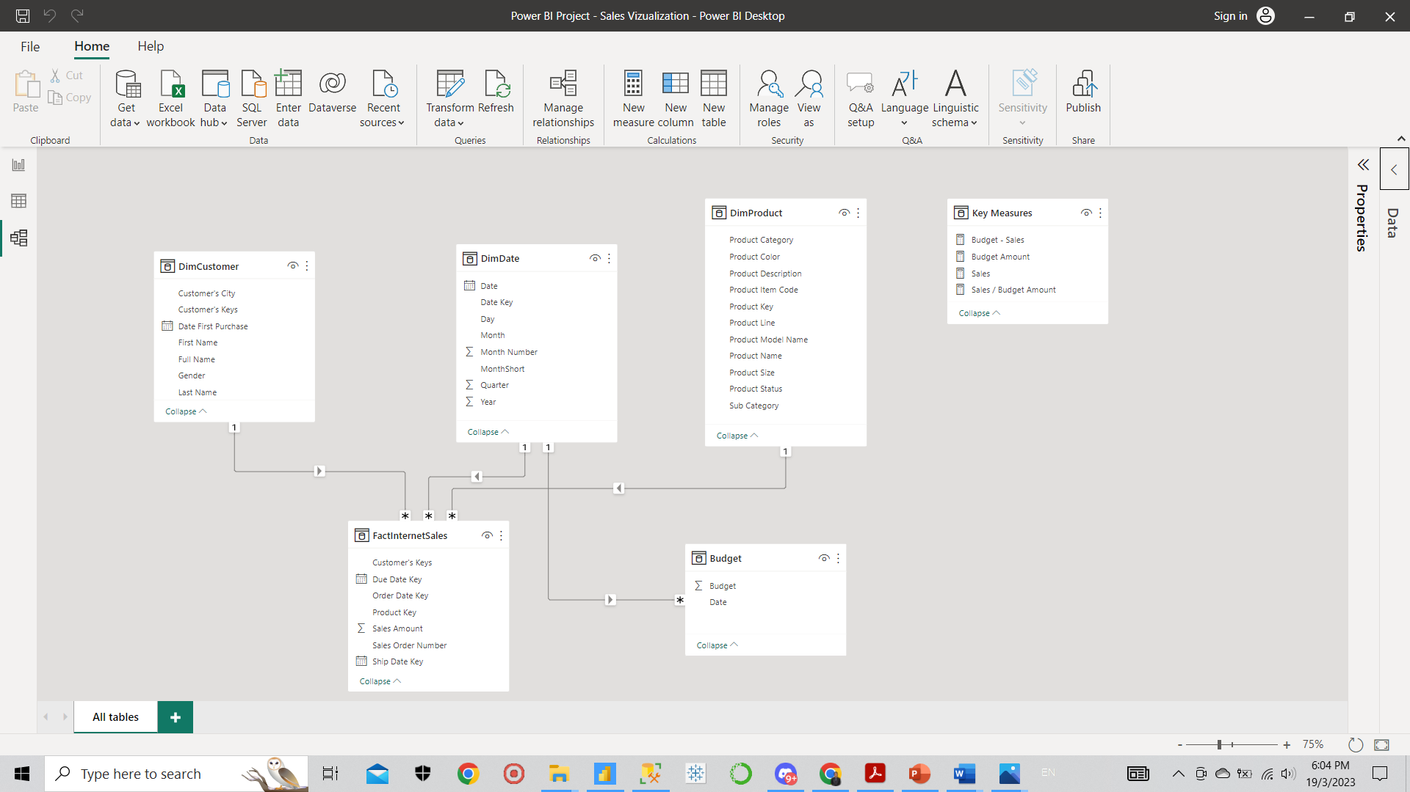
Upload Excel File and the Cleaned Dataset into PowerBI
Tools :
PowerBi
What to do?
Upload the already cleaned datasets which are DimCustomer Table, DimDate Table, DimProduct Table, and FactInternetSales Table from AdventureWorksDW2019.bak database to PowerBI.
Upload also the excel file which is Budget Dataset to PowerBI
Making database connections (Data Modelling)
Upload queries to PowerBI

Slide 7
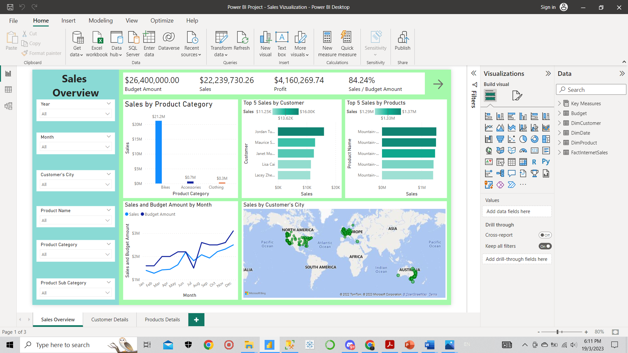
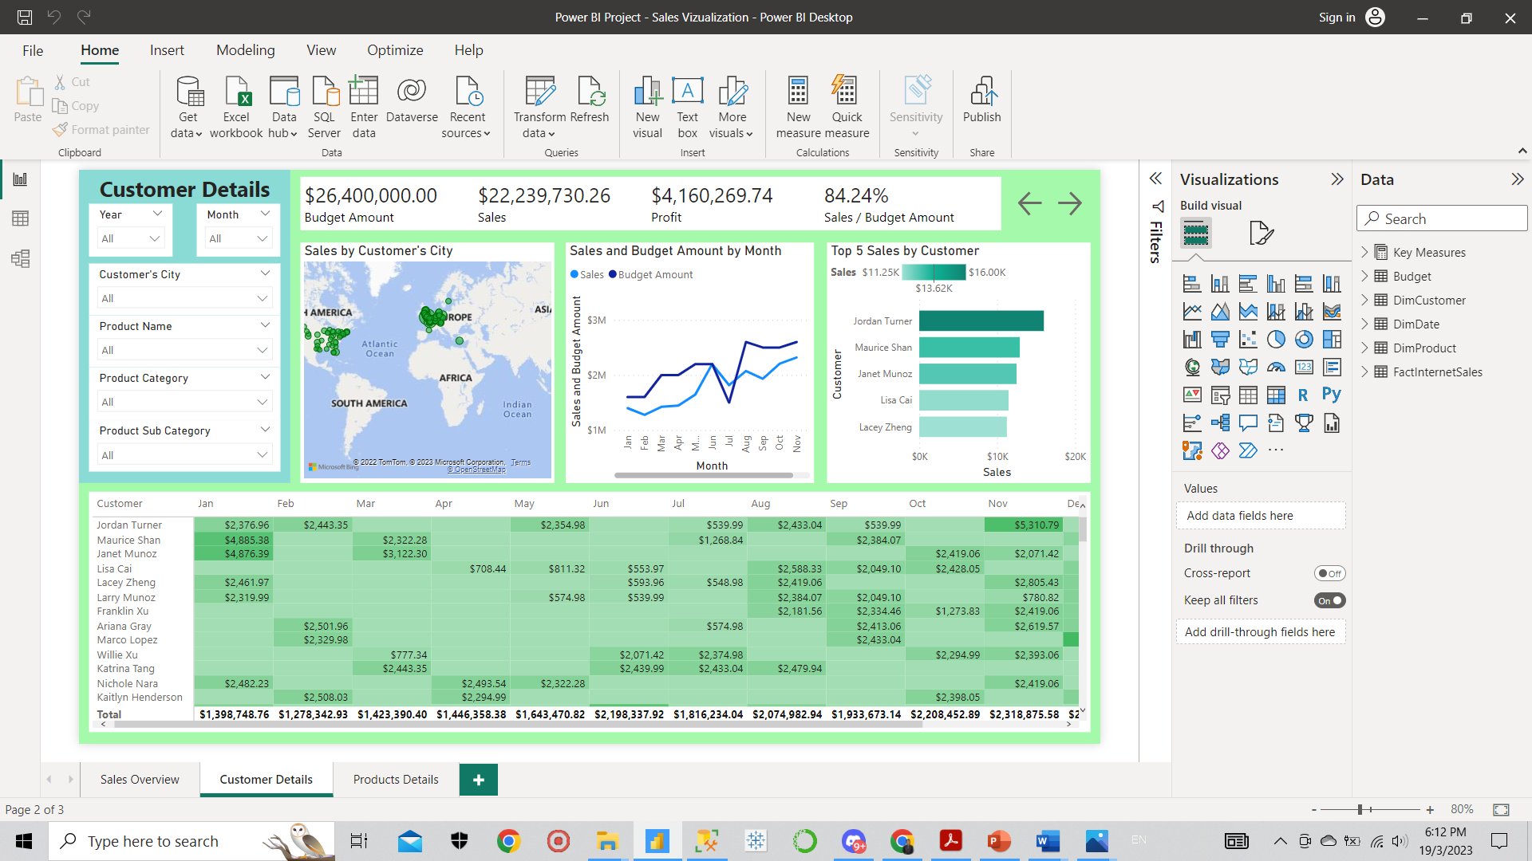
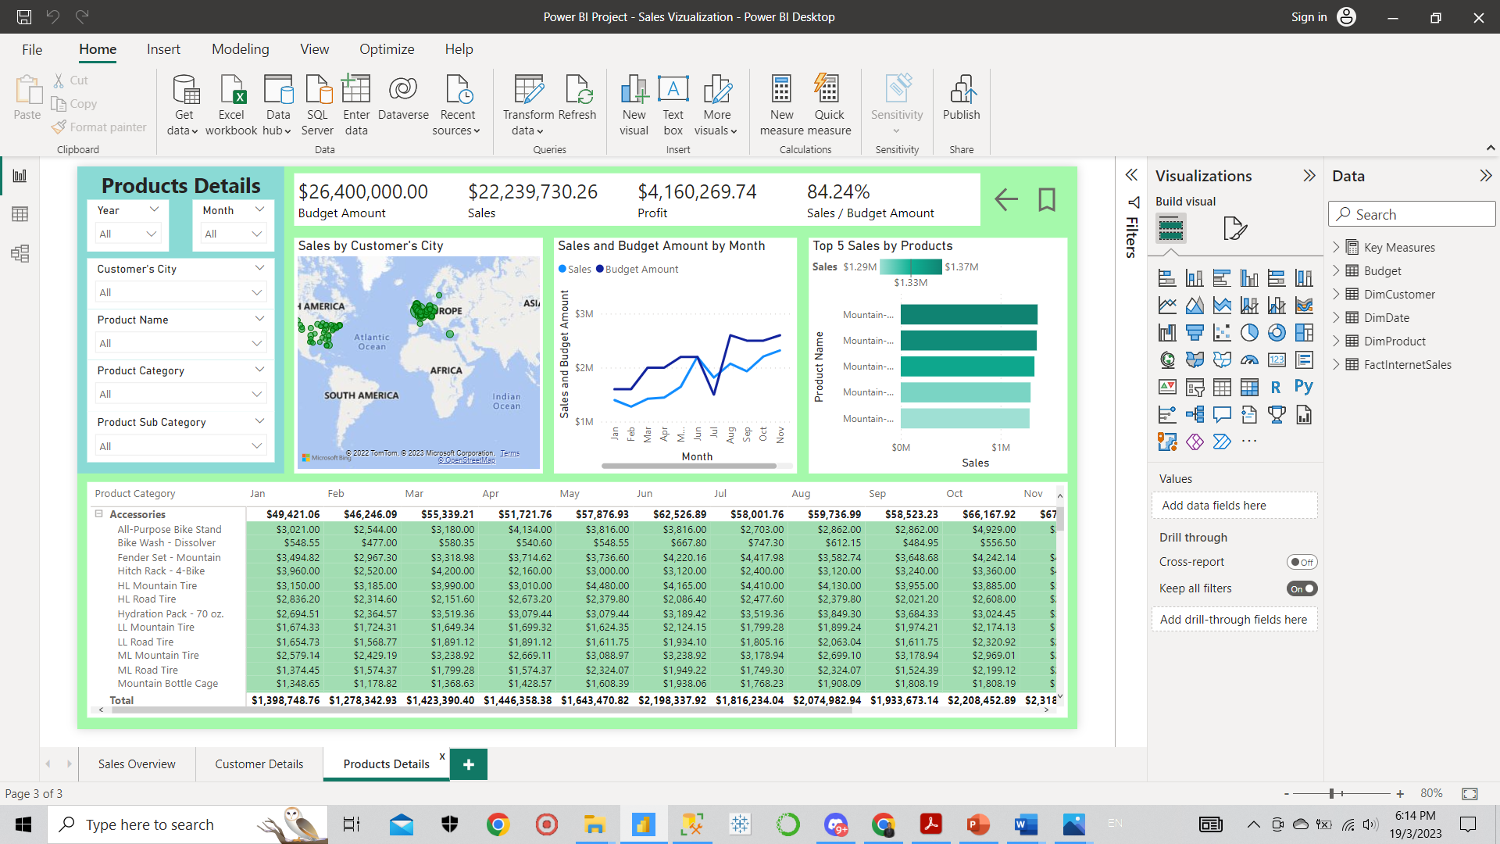
Making Interactive Dashboard
What to do?
Making the Sales Overview, Customer Details, and Product Details pages to put the useful information.

Slide 8
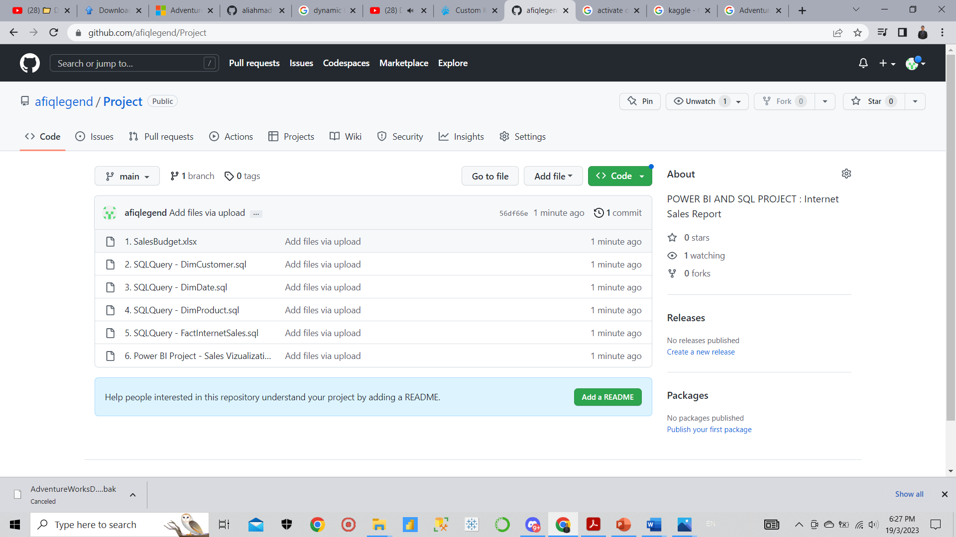
Upload Into Github
What to do?
Upload all my project files into Github for completing the portfolio.
Link : https://github.com/afiqlegend/Project

Slide 9
Conclusions
The results and possible implementations:
1. Succesfully identified the the products that have the best selling, so that can build selling strategy by only limit
and focus the advertisement to the following products.
2. Can focus to which customers that buy the products the most to plan the customers repeating buying strategy, so
it is possible to make membership program to ensure the repeating buying by customers can be frequently done.
Identify the profit to plan for selling strategy, so that we can reducing the budget by finding the bigger production
manufactures to get the best price to make frequent stocking.
What I have learnt:
How to make the queries in SSMS to clean the dataset to be the useful information for reporting and visualization
purpose.
How to make data modelling in PowerBI to ensure all tables are connected.
How to make interactive dashboard to summarize a lot of figure and text to the visual report to absorb the data easier.
Learn a little of business logics.

